Slide 2
CREDENTIALS
PARTNERS
INTERESTS AND INFLUENCE
LEADERSHIP

Slide 3
Informing policy
Research. Analysis. Dissemination.
18 years
113 publications
60 projects
80 partners

Slide 4
CREDENTIALS
PARTNERS
INTERESTS AND INFLUENCE
LEADERSHIP

Slide 5
UNICEF
UNDP
UNCTAD
World Food Programme
The World Bank
Asian Development Bank
The Global Fund
Office of the Secretary General Envoy on Youth
International Bank For Reconstruction
and Development
Bajaj Hindustan Ltd
Cargil India Private Ltd
Delta Lloyd
Facebook
GIZ
GMR
IBM
IKEA
Intel
IPE Global Limited
Mastek
Microsoft
PricewaterhouseCoopers
Qualcomm
Sanei
British High Commission
Centre for Promotion of Imports, Govt. of The Netherlands
Competition Commission of India
DFID, Govt. of UK
Government of Madhya Pradesh
Govt. of Andhra Pradesh
Govt. of Delhi NCR
Govt. of Odisha
Govt. of Telengana
Govt. of Uttarakhand
Kerala Start-up Mission
Ministry of Human Resource, Govt. of India
Ministry of Law and Justice, Govt. of India
NITI Aayog
NOW-WOTRO Science for Global Development, Govt. of The Netherlands
Planning Commission of India
Carnegie India
Catholic Health Association of India
Centre for Civil Society
Development Alternatives
Digital Empowerment Foundation
IKEA Foundation
Janaagraha
NORRAG, Switzerland
Micro Credit Summit Foundation (MCSF)
Oxford Policy Management
RESULTS Educational Fund (REF)
Sewa Bharat
World Resources Institute
AmCham Belgium
Cement Manufacturers Association
Confederation of Indian Industry
Federation of Indian Industries
Internet and Mobile Association
of India (IAMAI)
National Seed Association of India

Slide 6
Dr. B.R. Ambedkar University of Social Sciences, India
Centre for Policy Research, New Delhi
Copen Hagen Business School
Development Management Institute, Patna
Centre for Development and Human Rights
Georgia Tech
Gokhale Institute of Politics and Economics
Harvard University
Indian Council for Research on International Economic Relations (ICRIER)
Indian Institute of Management, Ahmedabad
Indian Institute of Management, Bangalore
Indian Institute of Technology, Indore
Indian School for Development Management
Indian School of Public Policy
Indian School of Business, Hyderabad
Institute of Developing Economies Japan External Trade Organization (IDE-JETRO)
Institute of Economic Growth, India
J-Pal South Asia
International Crops Research Institute for the Semi-Arid
Tropics (ICRISAT)
Mumbai School of Economics and Policy
University of Lapland
London School of Business and Finance
National Council of Applied Economic Research (NCAER)
National Institute of Educational Planning and Administration
National Institute of Public Finance and Policy
National Institute of Tuberculosis and Respiratory Diseases
National University of Education Planning and Administration
North American Aerospace Defense Command (Norad)
RUTGERS
The University of British Columbia
University of Gothenburg, Sweden
University of Groningen, Sweden
US Santa Cruz
VV Giri National Labour Institute
Wageningen University and Research, The Netherlands

Slide 7
CREDENTIALS
PARTNERS
FOCUS AND INFLUENCE
LEADERSHIP

Slide 9
Partners: UNDP and IKEA Foundation
Project: Disha
Partners: IAMAI and Govt. of Kerala
Project: Internet readiness and mobile app start-up ecosystem of Kerala
Improved skilling ecosystem to connect women
to income opportunities.
Internet readiness of Kerala for mobile app startups.
Partners: DFID, Govt. of UK, Govt. of Odisha, IPE Global
Project: Odisha Secondary School Girls Incentive Programme(OGIP)
Sponsor: Qualcomm Inc.
Project: Intellectual property rights and Standard essential patents
Cash transfers to incentivise enrollment and retention of girls in secondary school.
Policy briefs on India’s patent system for relevant ministries and regulatory bodies.
Study the interplay between household behaviour and decision making.
Establish the impact of development funding on beneficiaries, implementers and networks.
Project: Using novel data for public policy research
Partner: Facebook
Project: MFS II evaluation for Dutch Govt.
Partner: Univ. of Groningen, Univ. of Wagningen, NOW-WOTRO
Empirical explanation for the reasons of patenting by foreign firms in India.
Evaluate the impact of functional literacy to adult
illiterate rural women.
Project: R&D and patenting by foreign firms in India
Partner: NSTMIS, Government of India
Project: Impact evaluation of TARA Akshar+
Partner: Development Alternatives

Slide 10
CREDENTIALS
PARTNERS
INTERESTS AND INFLUENCE
LEADERSHIP

Slide 12
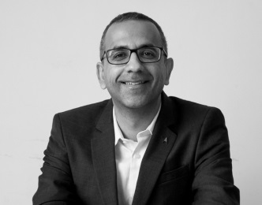
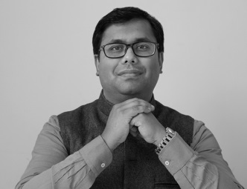
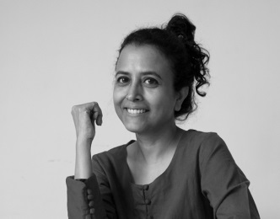
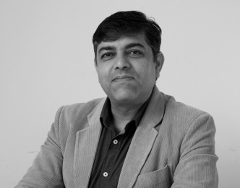
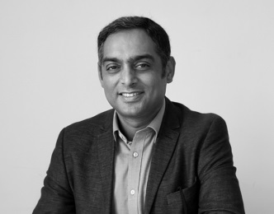
Dr. NISHANT CHADHA
Fellow and Head – Projects
Dr. ARIJIT DAS
Fellow
SOMA WADHWA
Fellow
Empirical economist
Expert in economics of education and technology and development
PhD from the University of British Columbia
Bachelor in engineering from IIT Kanpur
Economist
Expert in environment and energy economics
PhD from the Jawaharlal Nehru University
M.Sc. And B.Sc. in economics from University of Calcutta
Development studies researcher
Specialist in impact evaluation methodologies
Former editor at Outlook, The Indian Express,
The Hindustan Times, Open Magazine
Masters from St. Stephen’s College,
University of Delhi
VIJAY KELKAR Chairperson
SHUBHASHIS GANGOPADHYAY
Research Director
BHUPESH YADAV
Fellow and Head – Administration
Dr. NALIN MEHTA
Associate Scholar
Dr. BAPPADITYA MUKHOPADHYAY
Associate Scholar
Quantitative researcher
Expert in social accounting matrices (SAM)
Masters of Business Administration (Finance), University of Mumbai
Social scientist and journalist
Former editor at India Today, Times of India, Times Now, NDTV, Zee TV
PhD from La Trobe University, Melbourne.
Masters from University of East Anglia, UK
Economist
Professor, Great Lakes Institute of Management
Visiting professor, University of Ulm, Germany
Professorial associate, Victoria University, Australia
PhD from the Indian Statistical Institute

Slide 13
INDIA DEVELOPMENT FOUNDATION
www.idfresearch.org

